Slide 1
Credit Card Approval Prediction Using Machine Learning
Done By
Jesika G(team 4)

Slide 2
Introduction:
Overview:
Credit card approval prediction automates the evaluation of applications, reducing manual effort and improving accuracy.
Objective:
To develop a machine learning model that predicts credit card approval based on applicant data.

Slide 3
Problem Statement:
Manual credit card approvals are time-consuming and prone to bias.
Need for an automated, efficient, and unbiased system to predict approvals.
Accurate predictions can minimize defaults and enhance customer satisfaction.

Slide 4
Dataset:
Source:
https://archive.ics.uci.edu/ml/machine-learning-databases/credit-screening/crx.data
Features:
Applicant demographics (age, gender, etc.)
Financial details (income, debt, etc.)
Credit history (past defaults, credit score)
Target Variable:
Approval status (Approved/Rejected).

Slide 5
Methodology:
Data Preprocessing:
Handling missing values.
Encoding categorical data.
Scaling numerical features.
Exploratory Data Analysis (EDA):
Visualizing patterns and relationships.
Identifying outliers and anomalies.
Model Selection:
Logistic Regression, Decision Trees, Random Forest, etc.
Cross-validation for model evaluation.
Evaluation Metrics:
Accuracy, Precision, Recall, F1 Score, ROC-AUC.

Slide 6
Conclusion:
Machine learning enables faster and more accurate credit card approval.
Reduces human bias and enhances efficiency.
Future work: Incorporate advanced techniques like deep learning or real-time prediction systems.

Slide 7
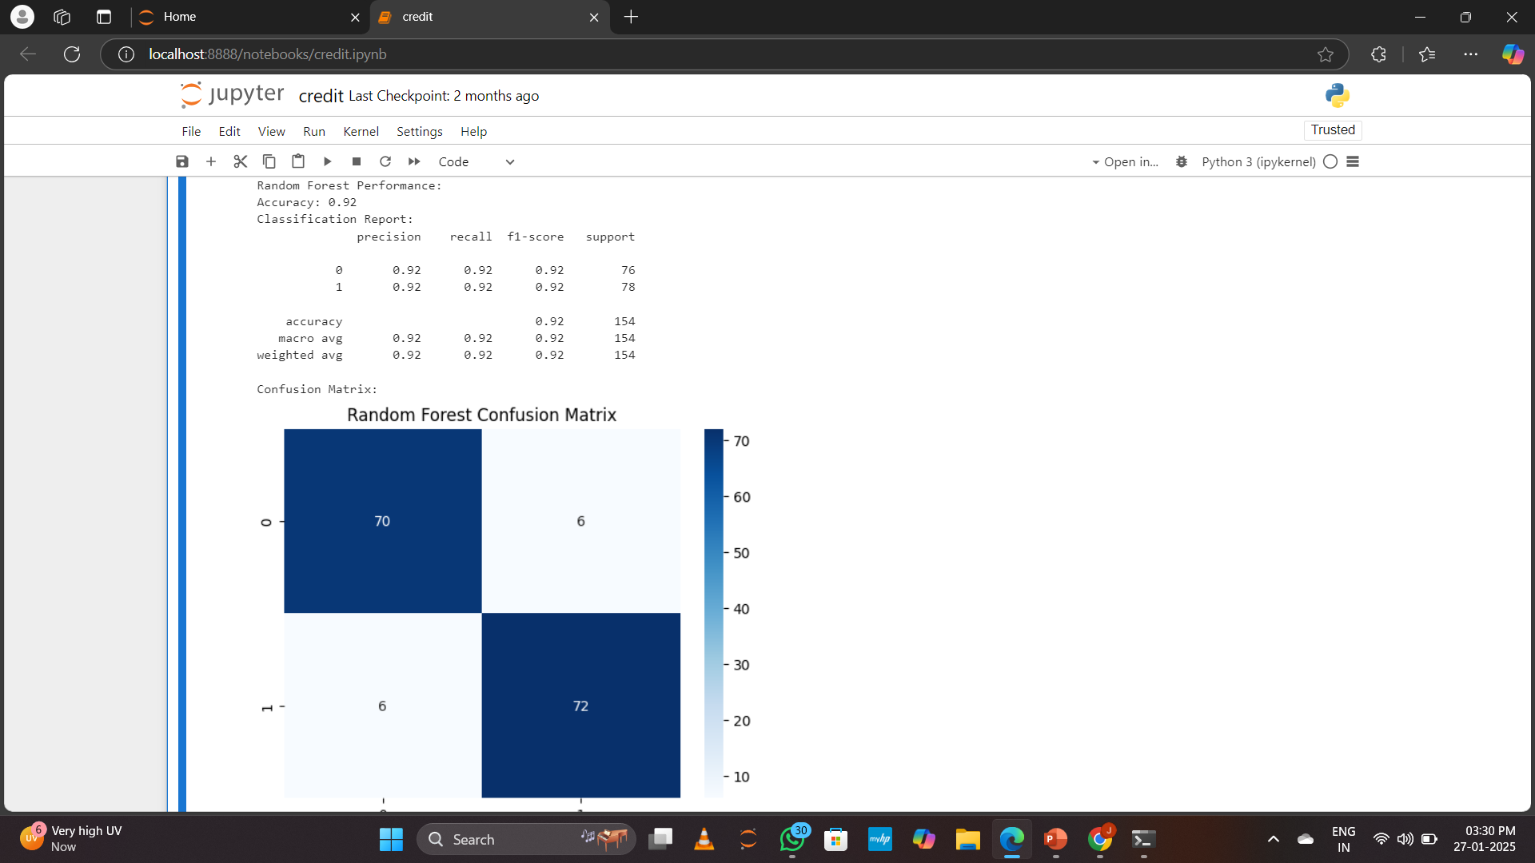
Output pic:(Random forest)

Slide 8
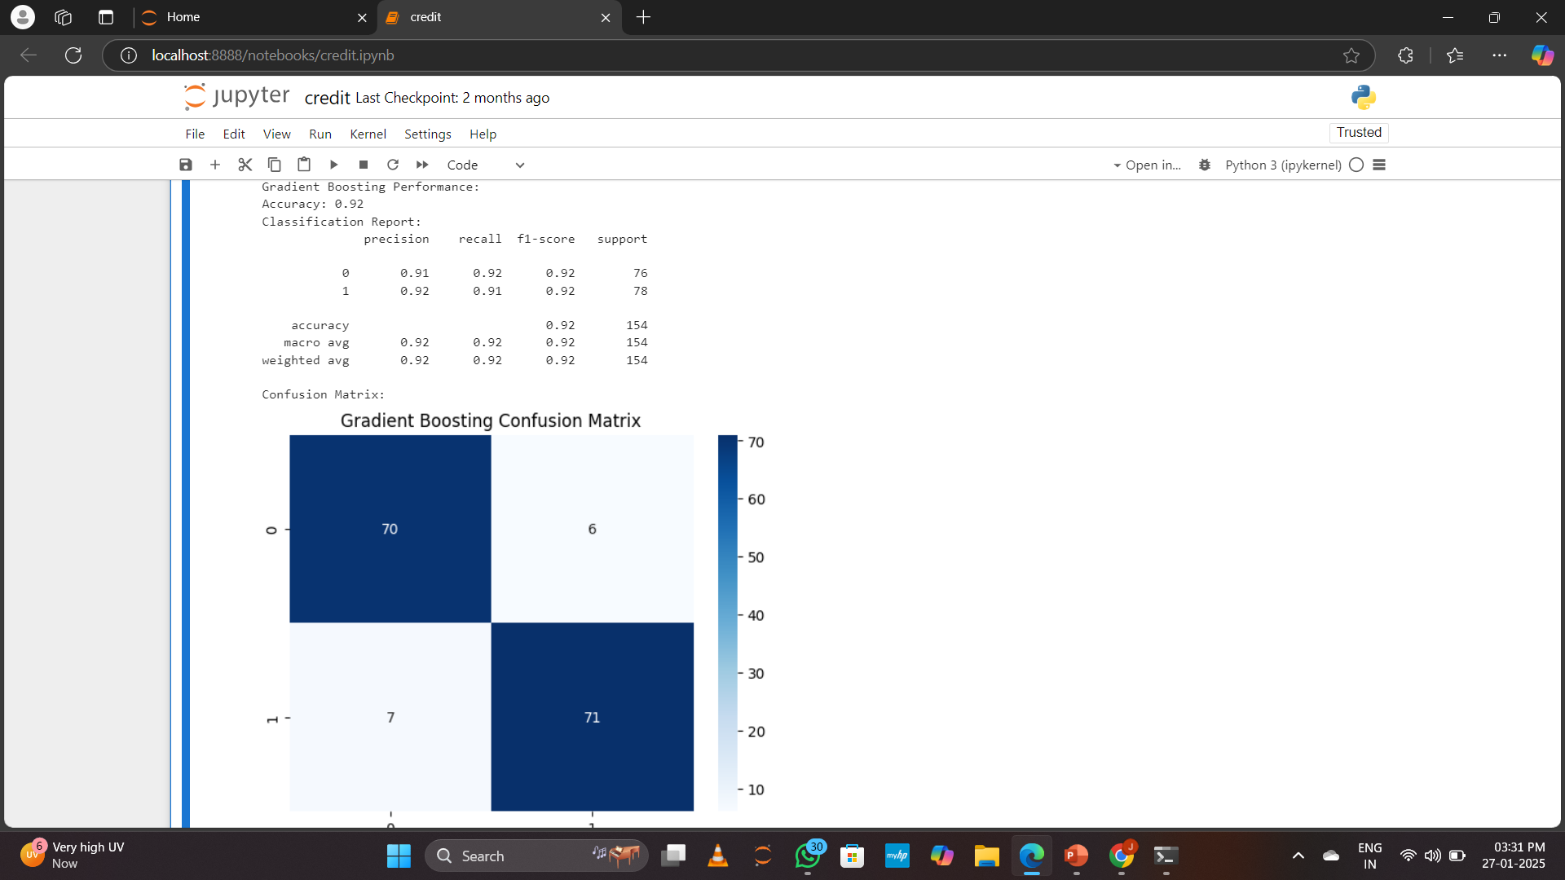
Gradient Boost :

Slide 9
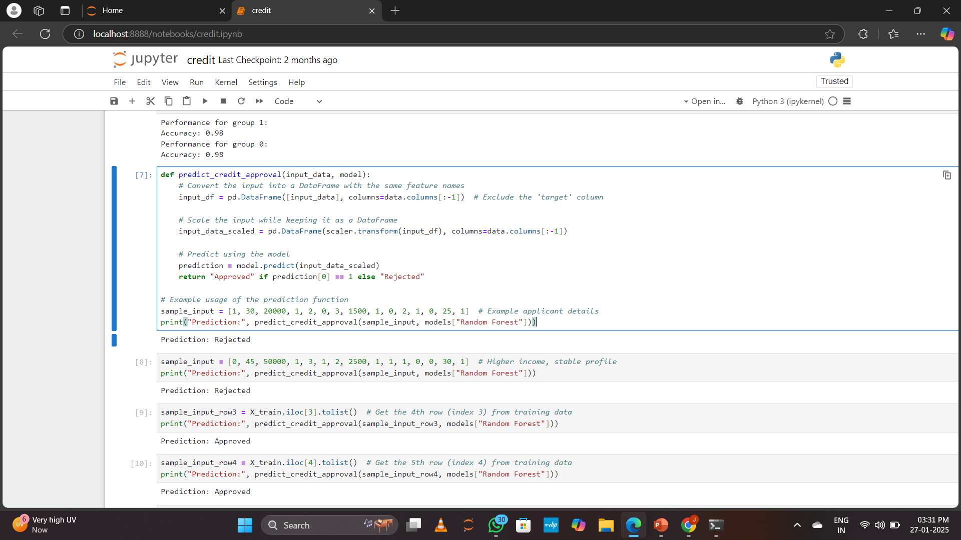
Acceptence Vs rejection:

Slide 10
Thankyou all…

